Slide 1



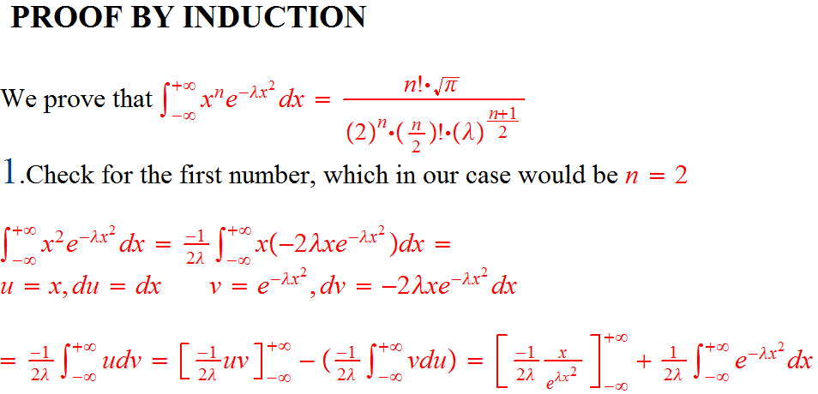
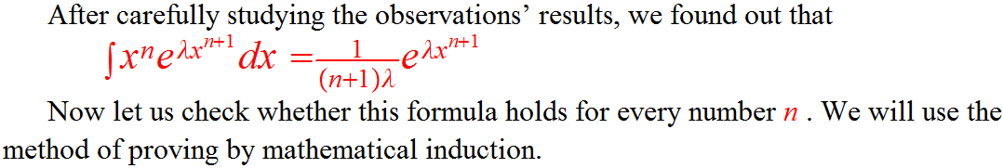


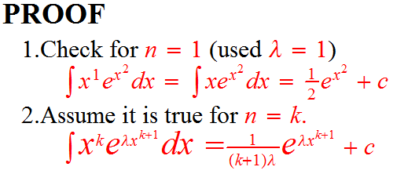
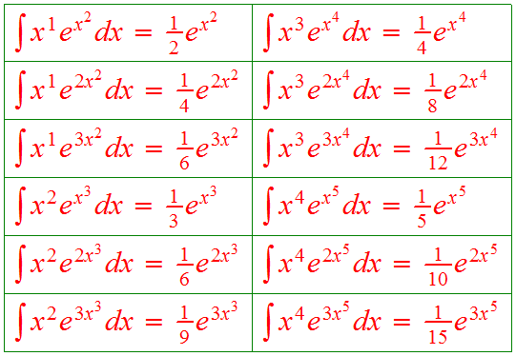
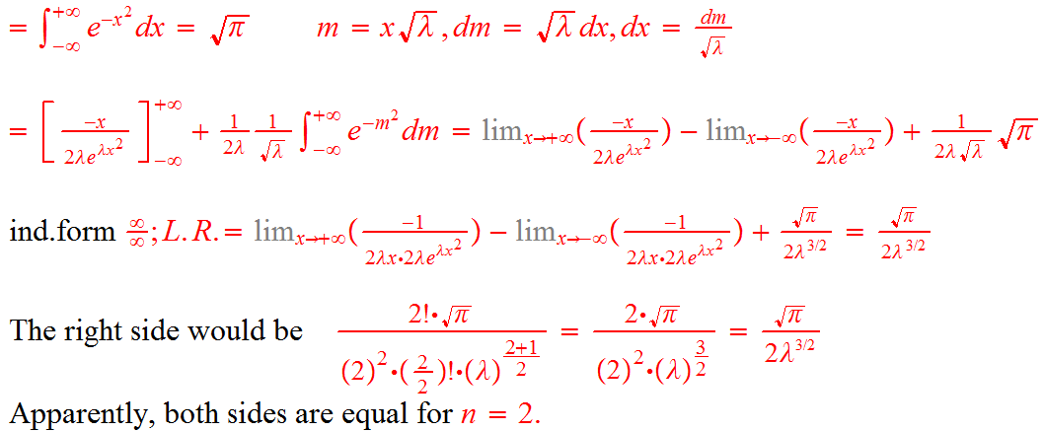
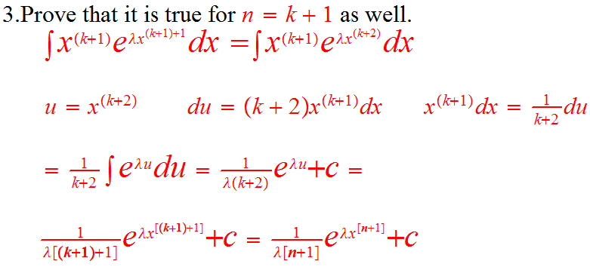


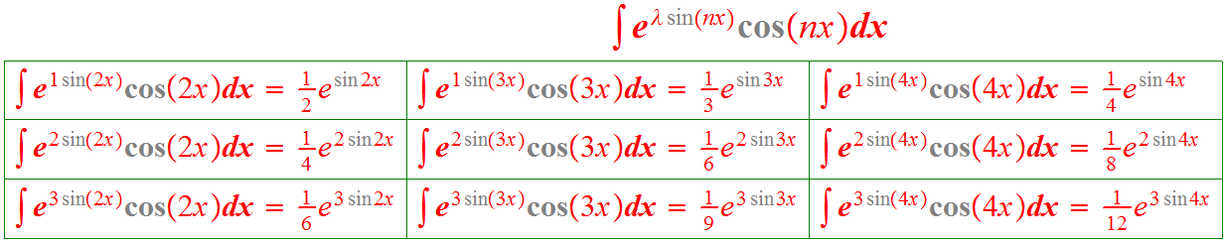
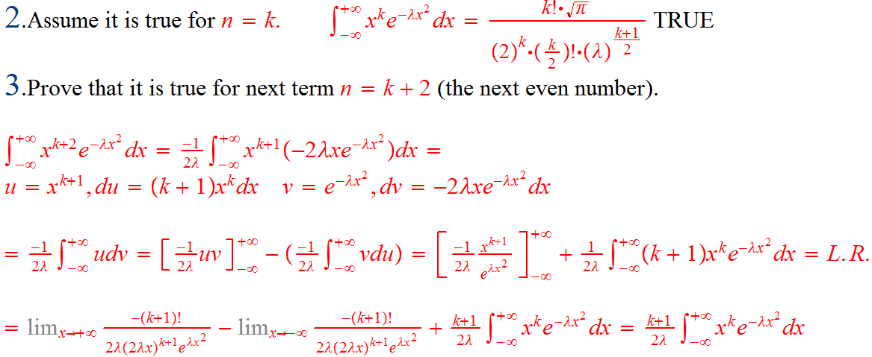
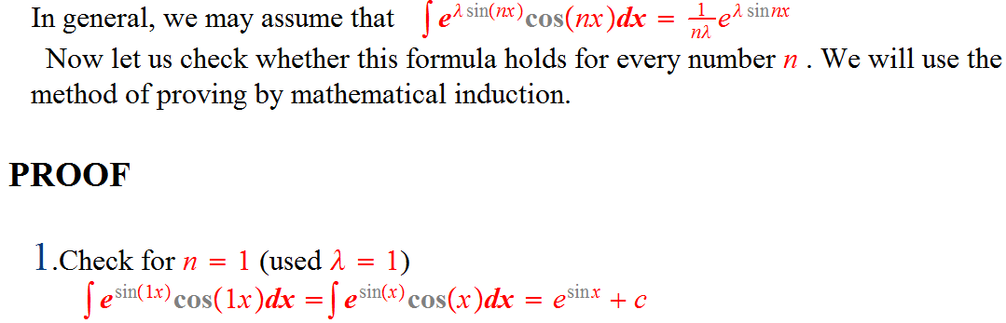
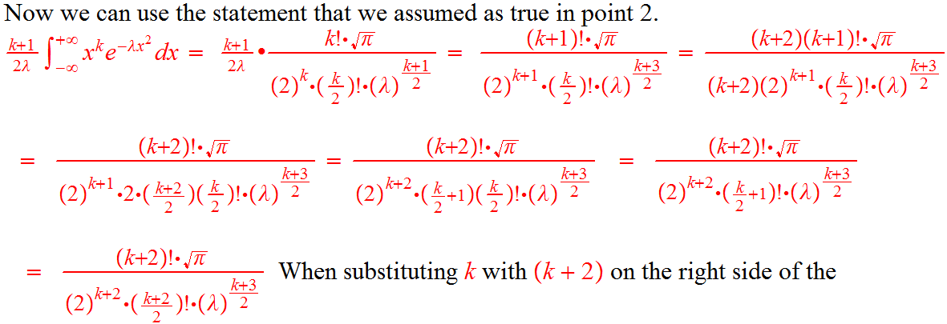
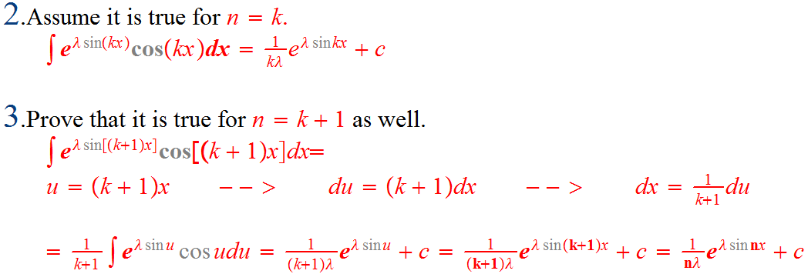
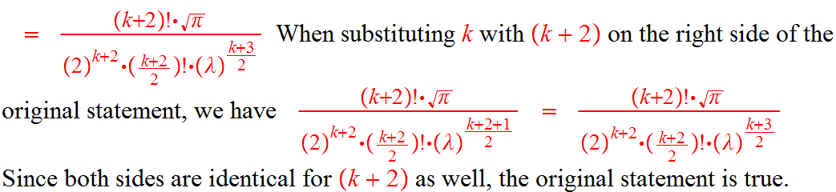
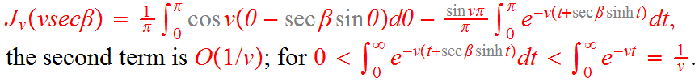
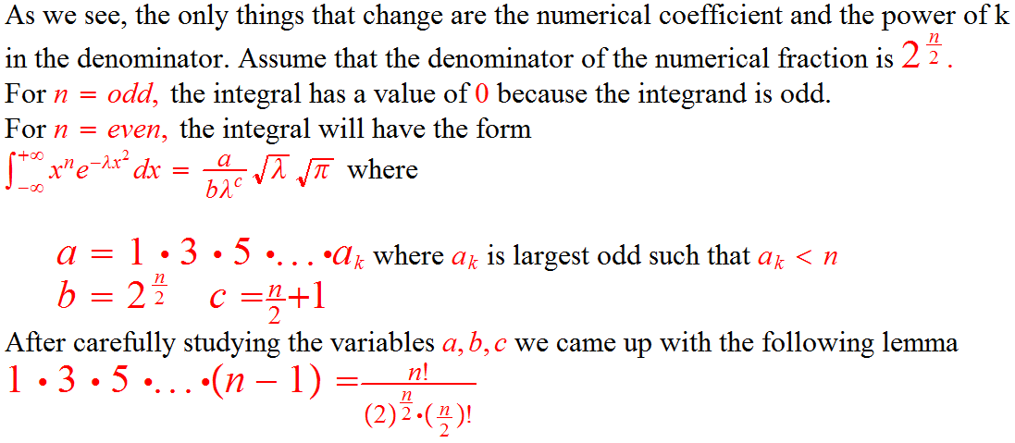


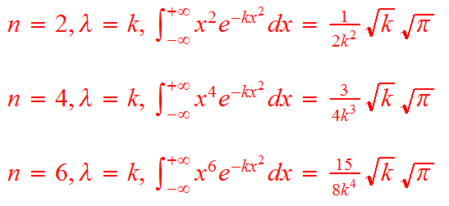

Oscillatory Integrals of the first kind
Presenter: Jurgen Xhafaj Advisor: Dr. Al-Hasan
Abstract and Introduction
Observation 1
In the integral ,let λ be a large positive constant, and let φ(x) and ψ(x) be real and continuous in α≤x≤β. Then the major contributions to the value of the integral evidently arise from the neighborhoods of the points at which φ(x) attains its greatest value in the calculus sense. [ETC]
Integrals of the form are called oscillatory integrals of the first kind. They arise in many areas of mathematics. There are many variations. This integral may involve one or more variables; the variables may be real or complex; the integral may be global or taken over a small neighborhood or oddly shaped set; varying degrees of smoothness may be assumed; and varying degrees of degeneracy may be allowed near the critical points of the phase function, φ [RPMC] Our main work will be with integrals of the form
Observation 2
Early research
Oscillatory integral operators have been of interest to both mathematicians and physicists ever since the emergence of the work "Theorie Analytique de la Chaleur" of Joseph Fourier in 1822, in which his chief concern was to give a mathematical account of the diffusion of heat. For example, oscillatory integrals naturally arise when one studies the behavior at infinity of the Fourier transform of a Borel measure that is supported on a certain hypersurface. [KOWR]
One reduces the study of such a problem to that of having to obtain estimates on oscillatory integrals. However, sub-level set operators have only come to the fore at the end of the 20th Century, where it has been discovered that the decay rates of the oscillatory integral λ above may be obtainable once the measure of the associated sub-level sets are known. This discovery has been fully developed in a paper of A. Carbery, M. Christ and J. Wright [CCW] . A principal goal of that thesis is to explore certain uniformity issues arising in the study of sub-level set estimates.
The principle of stationary phase is of major importance in the study of oscillatory integrals. It was applied by Nicholson [NC] and Rayleigh to obtain approximate formulae for the Bessel functions J_{v}(v) and J_{v}(v secβ), where
which was approximated to
Similarly, has been approximated to
when v is large and positive and β is a positive acute angle.
Observation 3
References
[CCW] → A. Carbery, M. Christ and J. Wright, Multidimensional van
der Corput and sublevel set estimates, J.Amer. Math. Soc. (1999)
[ETC]E. T. COPSON. Asymptotic Expansions, Cambridge University
Press, Cambridge (1965)
[KOWR] Michael Wladislaw Kowalski, Jim Wright, A Comparative
Study of Oscillatory Integral, and Sub-level Set, Operator Norm
Estimates, University of Edinburgh (2010)
[NC] → Nicholson, Phil. Magazine (1909)
[RPMC] → Robin Pemantle and Mark C. Wilson, Asymptotic
expansions of oscillatory integrals with complex phase (2010)

